Slide 1
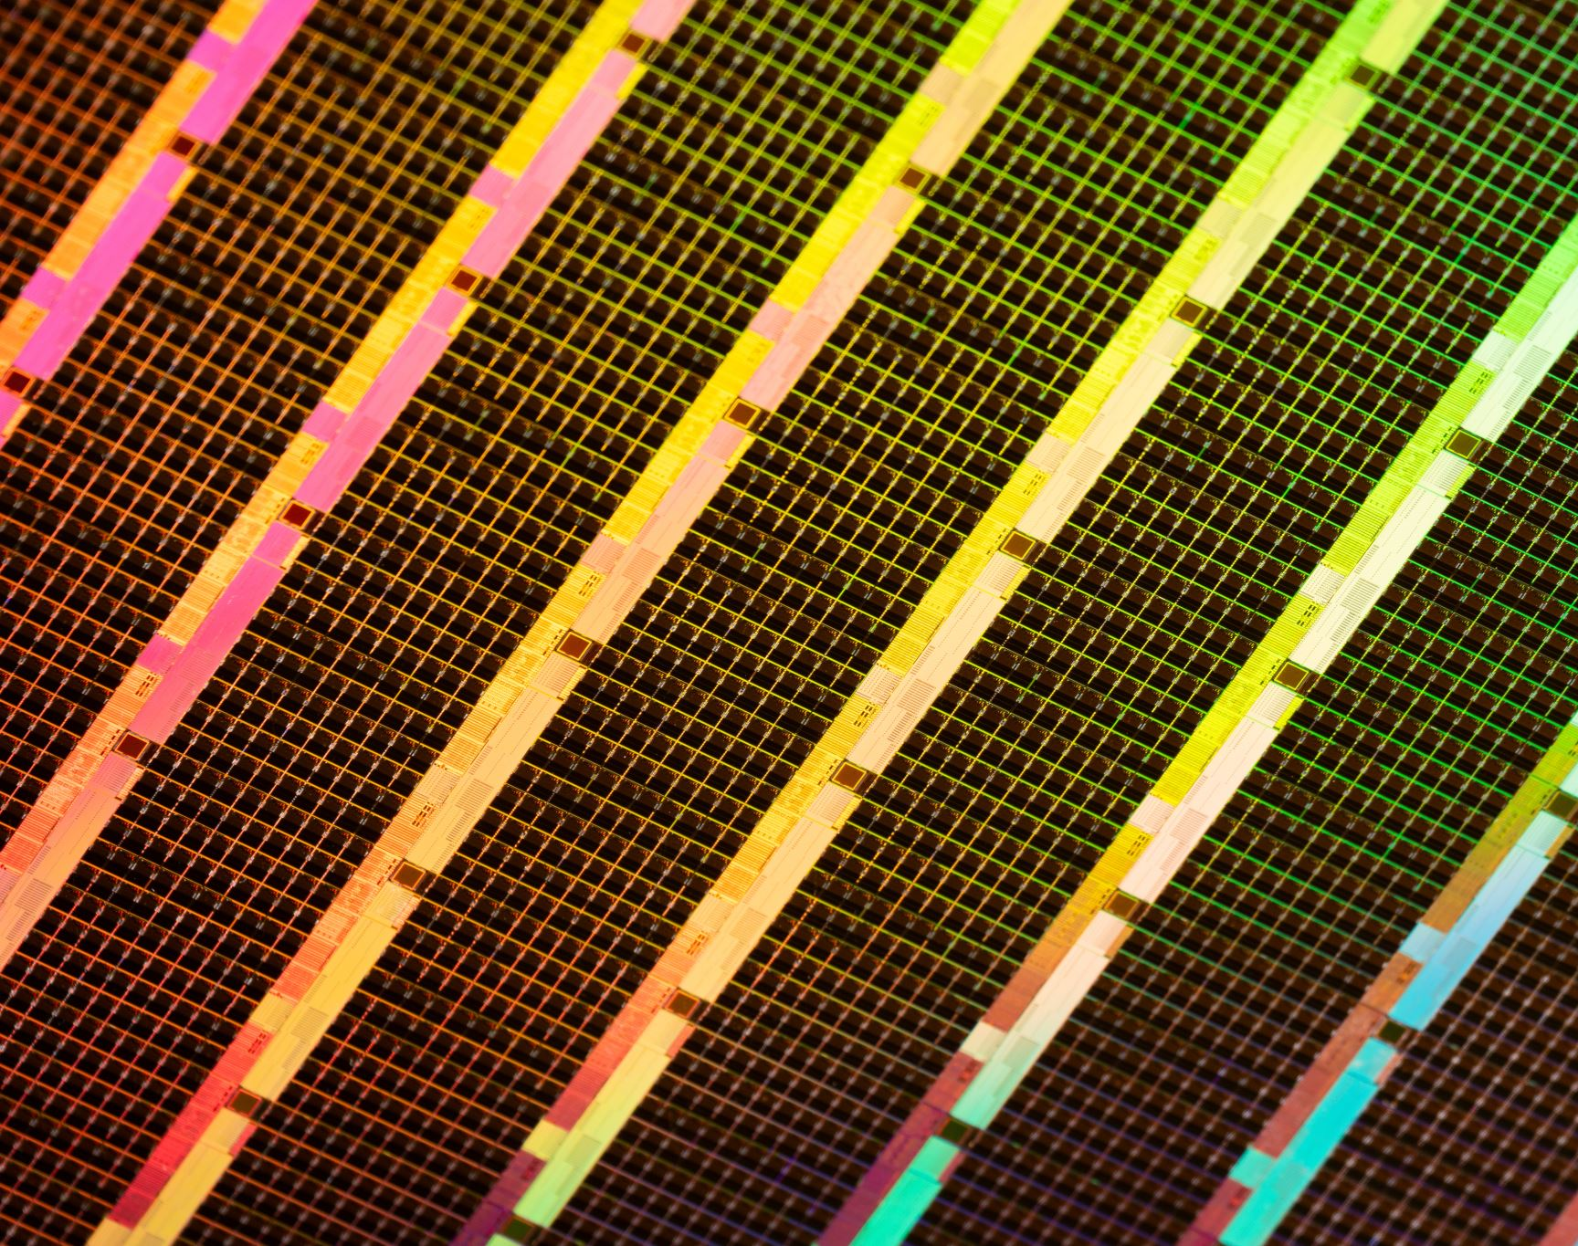
Audio Signal Denoising for Speech Intelligibility
Digital Signal Processing Project Overview
Ossi Sereda / 6614050044

Slide 2
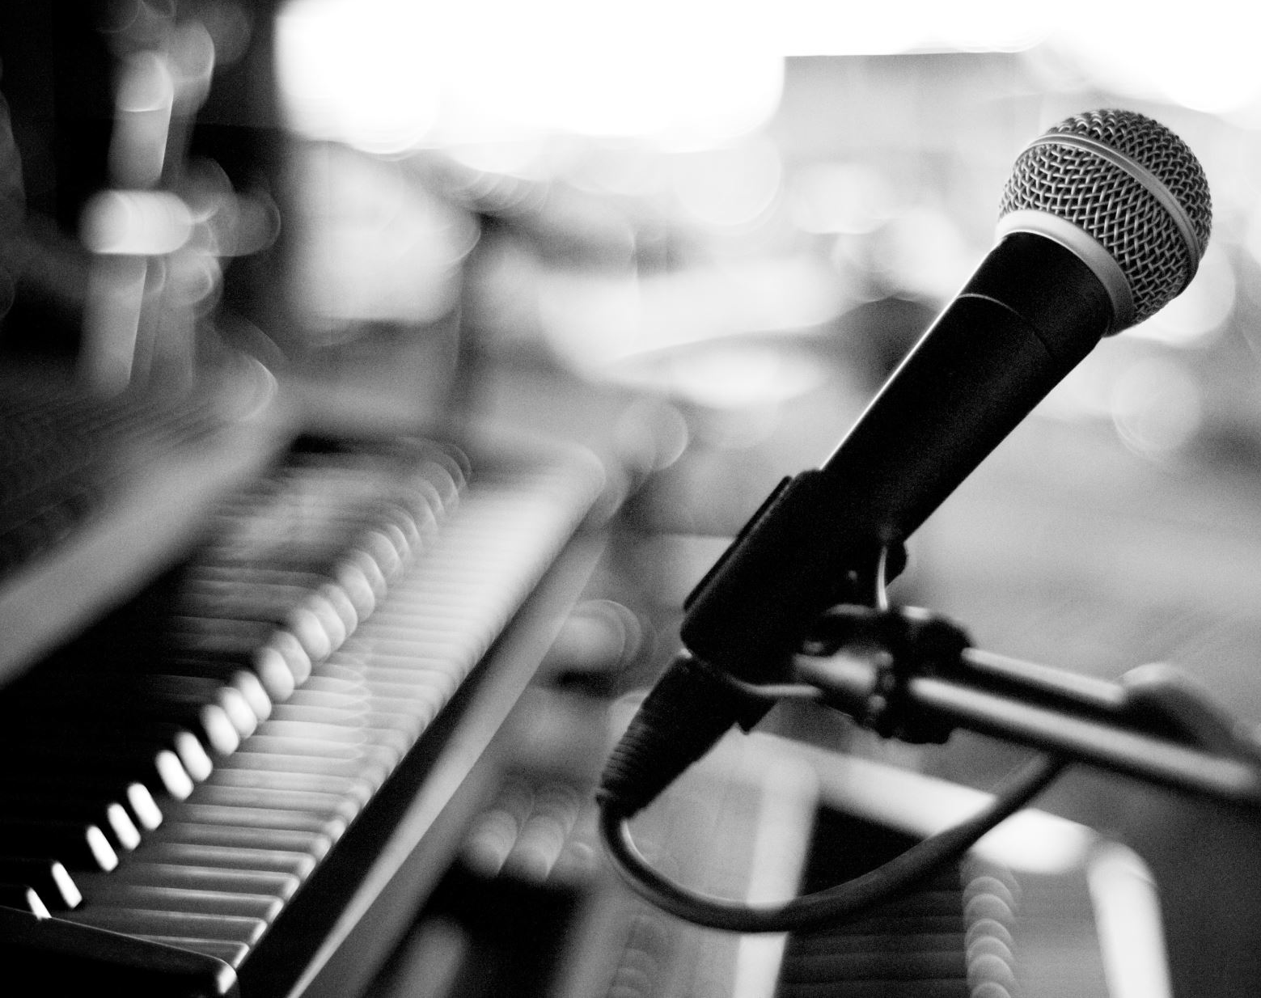
Problem Statement
How to remove unwanted noise from an audio recording?
Furthermore: How to make a recording of a speech with high background noise more intelligible?
Notes:
Why the problem was chosen: desire to learn Thai language, but having problems with word recognition due to low speech intelligibility

Slide 3
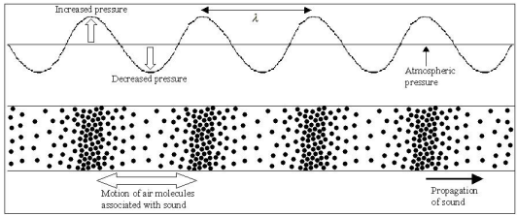
Sound signals
Sound, in general, is a [longitudinal] wave travelling in a medium (such as air)
Sound waves are created by object vibrations, which then create changes in pressure to the surrounding particles
f ≈ 20 Hz – 20 kHz
The bigger the pressure change, the bigger the volume of sound
Static air pressure = 101 300 Pa
Pressure changes observed in habitat are usually between 20*10^-6 Pa (0 dB) and 20 Pa (120 dB)
Sound waves carry initial energy provided by the source into multiple directions, mitigating the intensity of the sound the further it moves from the source
References: Hongisto, V. (2022). Rakennusakustiikka ja meluntorjunta. (Building acoustics and noise control)
Zola, A. (s.a.). What is a sound wave? Available: https://www.techtarget.com/whatis/definition/sound-wave
Notes:
Compare sound wave to a wave in water created by a droplet

Slide 4
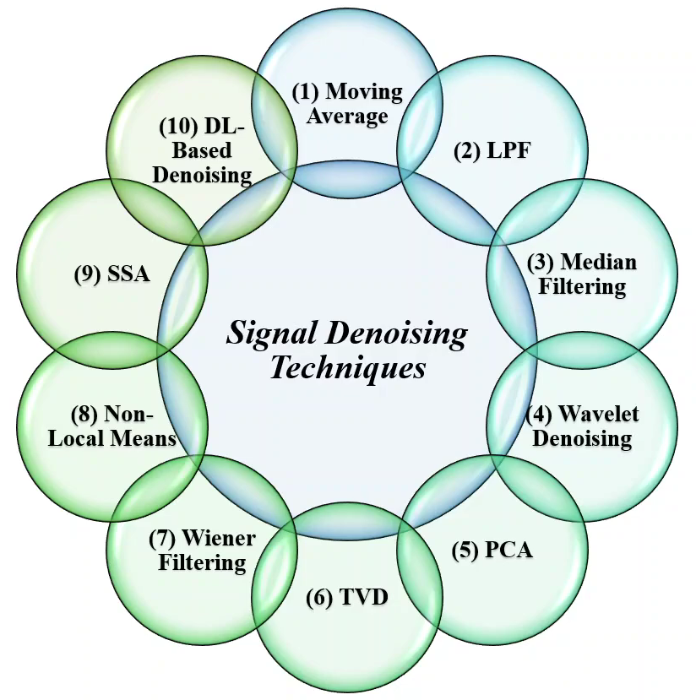

Related Solutions
Audio denoising

Slide 5
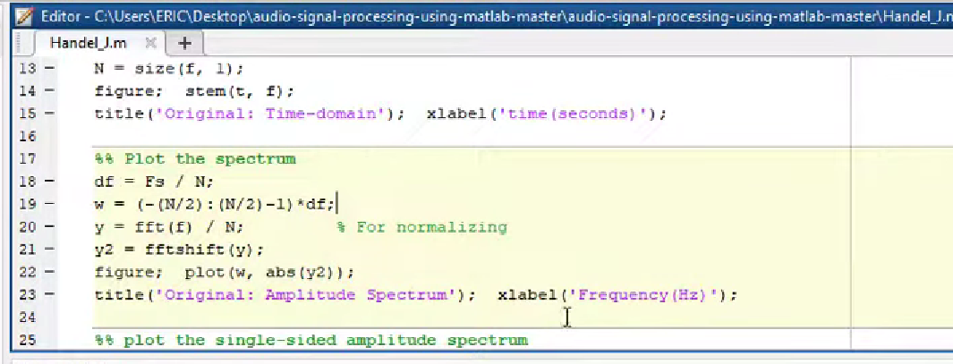
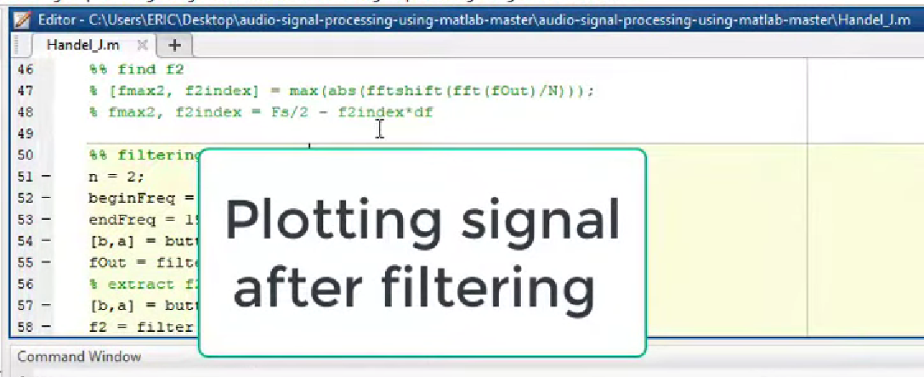
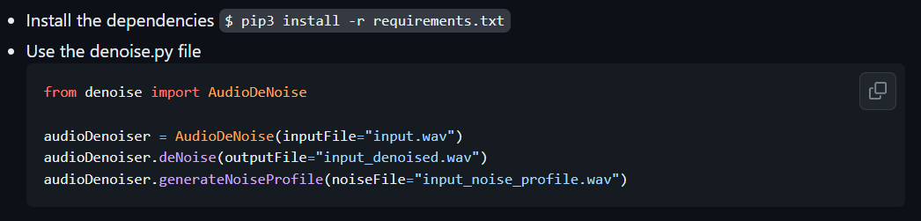
Denoising with MATLAB and Python
MATLAB and Python have libraries, that offer functions and filters to perform denoising with relatively easy scripting
More advanced scripts can also be found as open source
Different methods of denoising signals:
Filter-based denoising
Wavelet-based denoising
Deep learning-based denoising
References:
AskPython (s. a.). Denoising Images in Python – A Step-By-Step Guide.
https://www.askpython.com/python/examples/denoising-images-in-python
MathWorks (s. a.). What is Denoising?
https://se.mathworks.com/discovery/denoising.html
MATLAB Solutions (2021). Noise removal from Noisy Audio signal using filters in MATLAB https://www.youtube.com/watch?v=QC0Pl8sirXU
https://github.com/sa-if/Audio-Denoiser

Slide 6
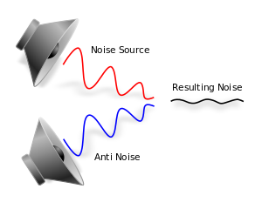
Destructive interference
Method of using one wave to cancel out another
For example, a source wave combined with a signal with inverted polarity
Used in for example active noise control
Applicable in multiple softwares, such as MATLAB, Python, Cubase...
References:
https://en.wikipedia.org/wiki/Active_noise_control https://stackoverflow.com/questions/36432343/how-to-get-pi-phase-from-sound-to-get-a-destructive-interference-in-python https://www.youtube.com/watch?v=pgcIICdc8lc

Slide 7
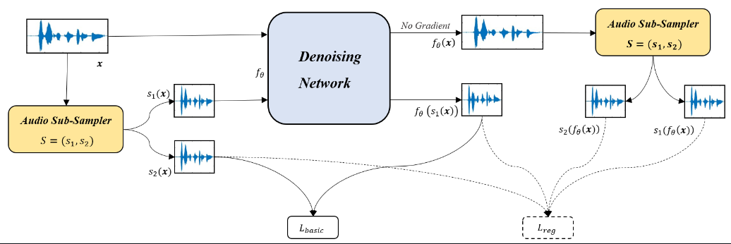

Only-Noisy Training (ONT)
A self-supervised speech denoising approach
Unlike traditional audio denoising tasks ONT does not need a clean signal as a target reference
Clean target signals usually require expensive recording equipment and studios with strict environments
Created with Python
Reference: Wu, J., Li, Q., Yang, G., Li, l., Senhadji, L. & Shu, H. (2021). Self-Supervised Speech Denoising Using Only Noisy Audio Signals.

Slide 8
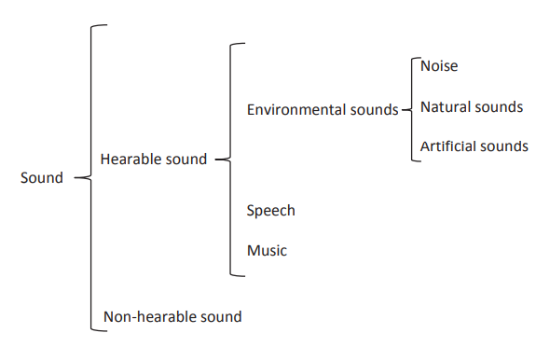
Machine hearing
More advanced approach into denoising audio signals
Techniques to extract audio features in a way for the machine to know, which part needs to be filtered
Speech is considered to be a ”usual” audio signal
Ways to extract usual signals already exist. It can be, however, further optimized
Reference: Alias, F., Socoro, J. C., Sevillano, X. (2016).
A Review of Physical and Perceptual Feature Extraction Techniques for Speech, Music and Environmental Sounds.

Slide 9
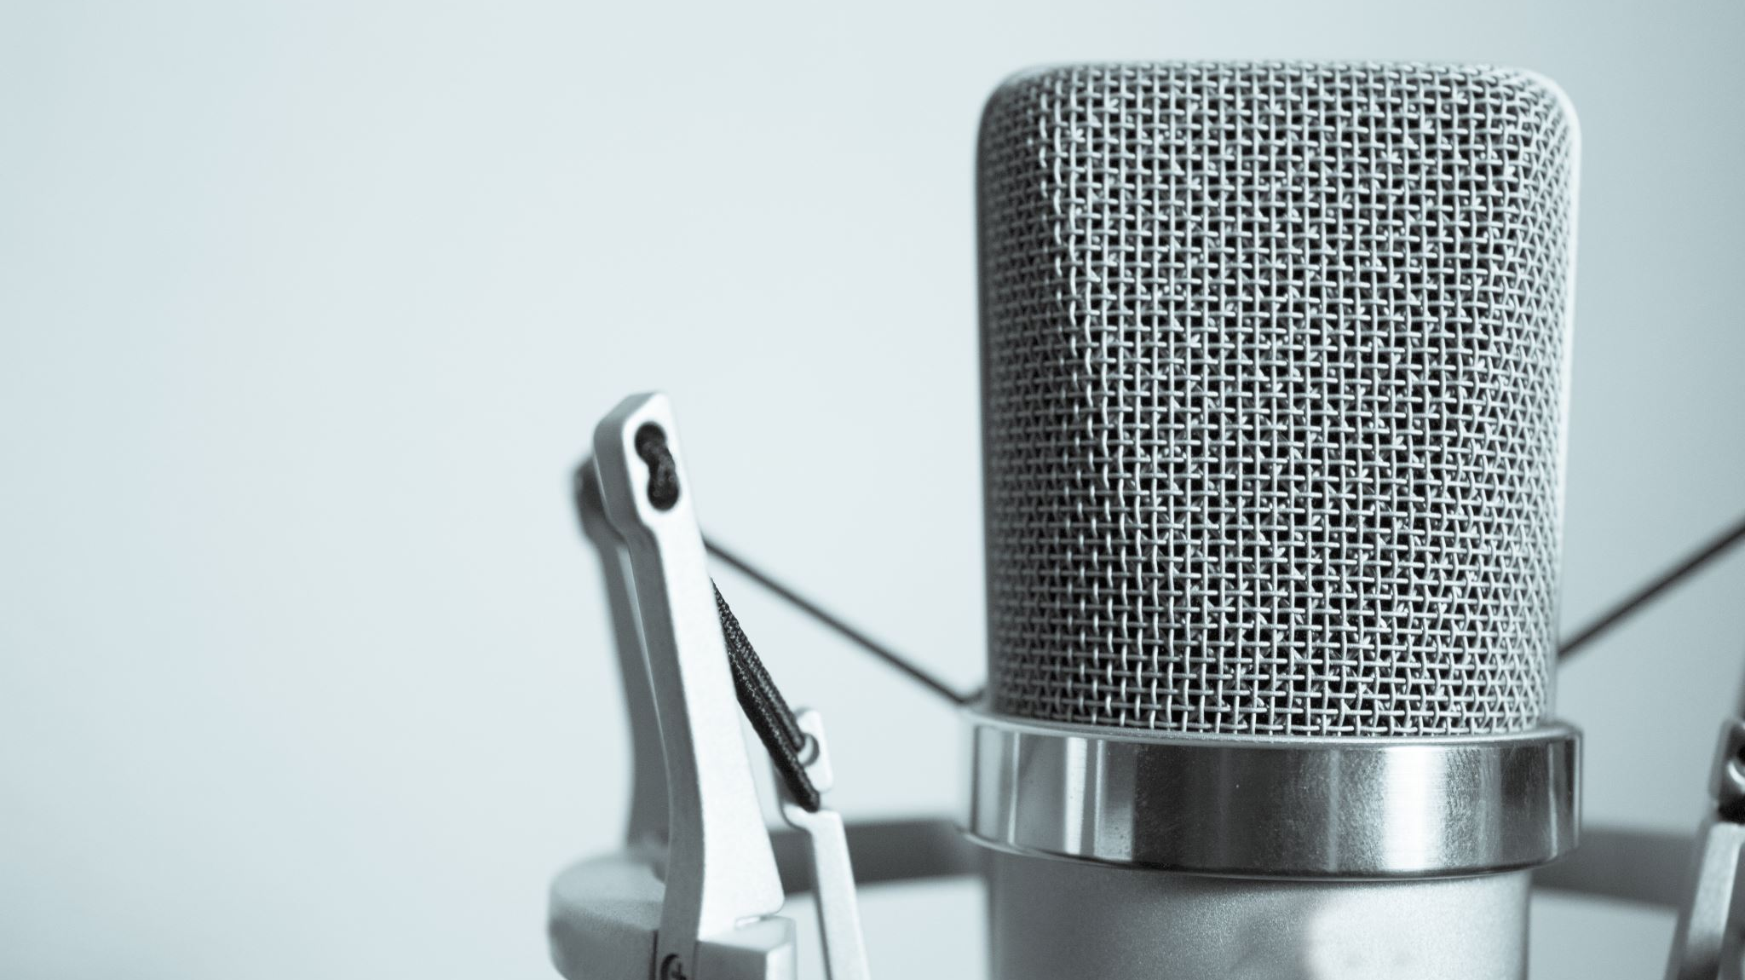
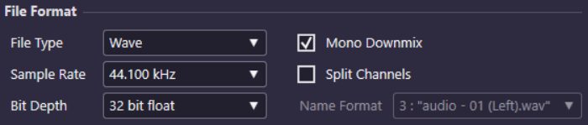
Problem approach – Data acquisition
Record speech in silent environment
Record speech in noisy environment
Record the ambient sound in noisy environment
Microphone around the same location in each recording
Equipment used:
Asus D509DA-EJ881T microphone
Cubase AI Elements 10
wav.-file
44 100 Hz Sample rate
32 bit
5 second samples

Slide 10
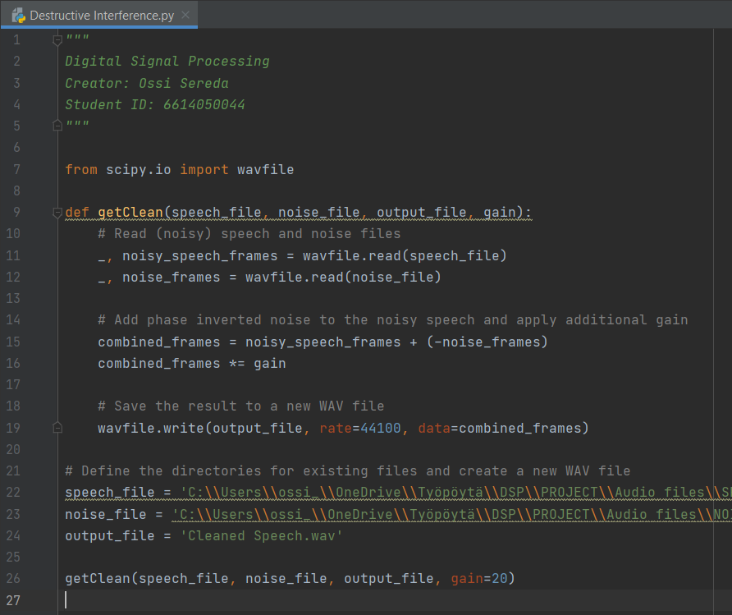

Problem approach – Data processing Approach 1: Destructive interference
Cleaned speech signal
Noise signal with inverted polarity
Speech + Noise
Clean speech signal
Noise signal
Gain increased
Without increasing gain
Python-based phase inversion for noise signal
The noise to be inverted is identical to the noise in the noisy speech

Slide 11
Problem approach – Data processing Approach 1: Destructive interference
What if the noisy speech signal has similar (but not identical) noise information as the noise signal to be inverted?
Cleaned speech signal?
Noise signal with inverted polarity
Speech + Noise (not combined from different files)
Even though the noise in the two signals is very similar to the human ear, the phase correlation is almost non existent, which makes using phase inversion like described earlier an irrelevant approach for this kind of problem

Slide 12
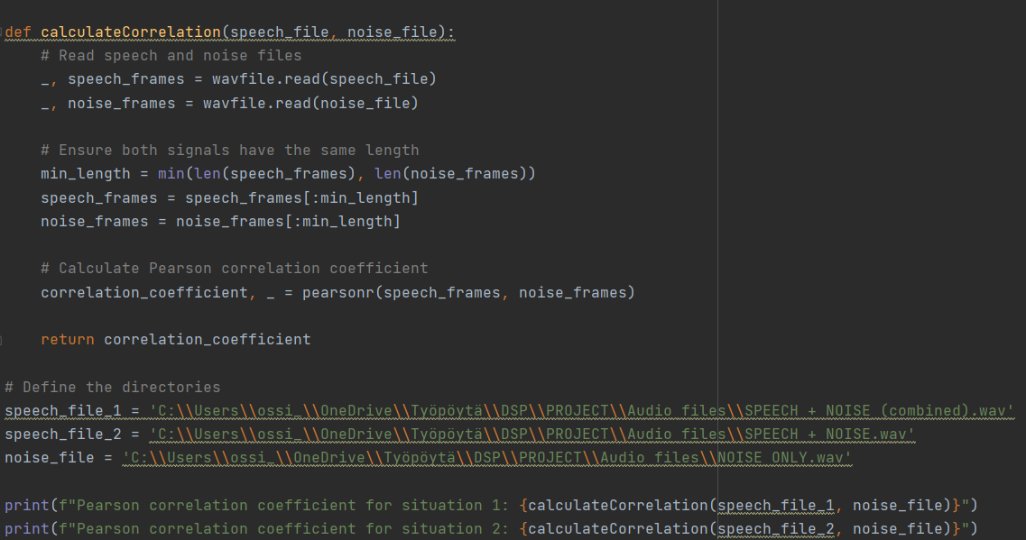

Slide 13
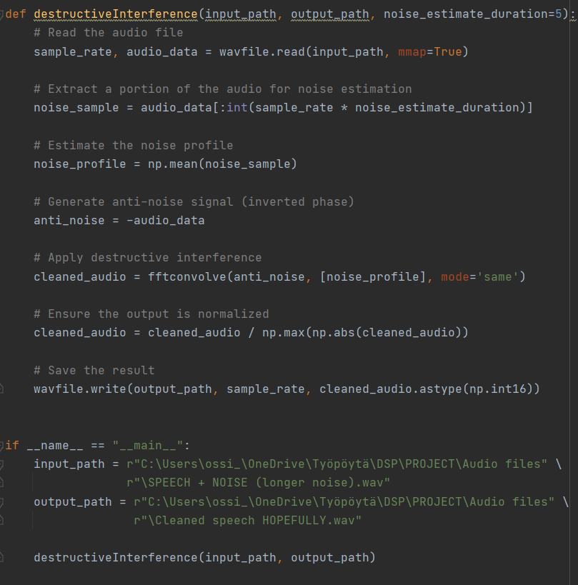
For a more comprehensive way to utilize phase inversion, a segment from the beginning of the audio file to be cleaned can be extracted and used to estimate the noise profile for the file
For this, a sample with at least 5 seconds of only noise in the beginning was used
With the extracted portion an estimated noise profile can be obtained, which then can be convolved with the phase inverted audio
This code, however, creates an output file that is cleaned of everything, both noise and speech

Slide 14
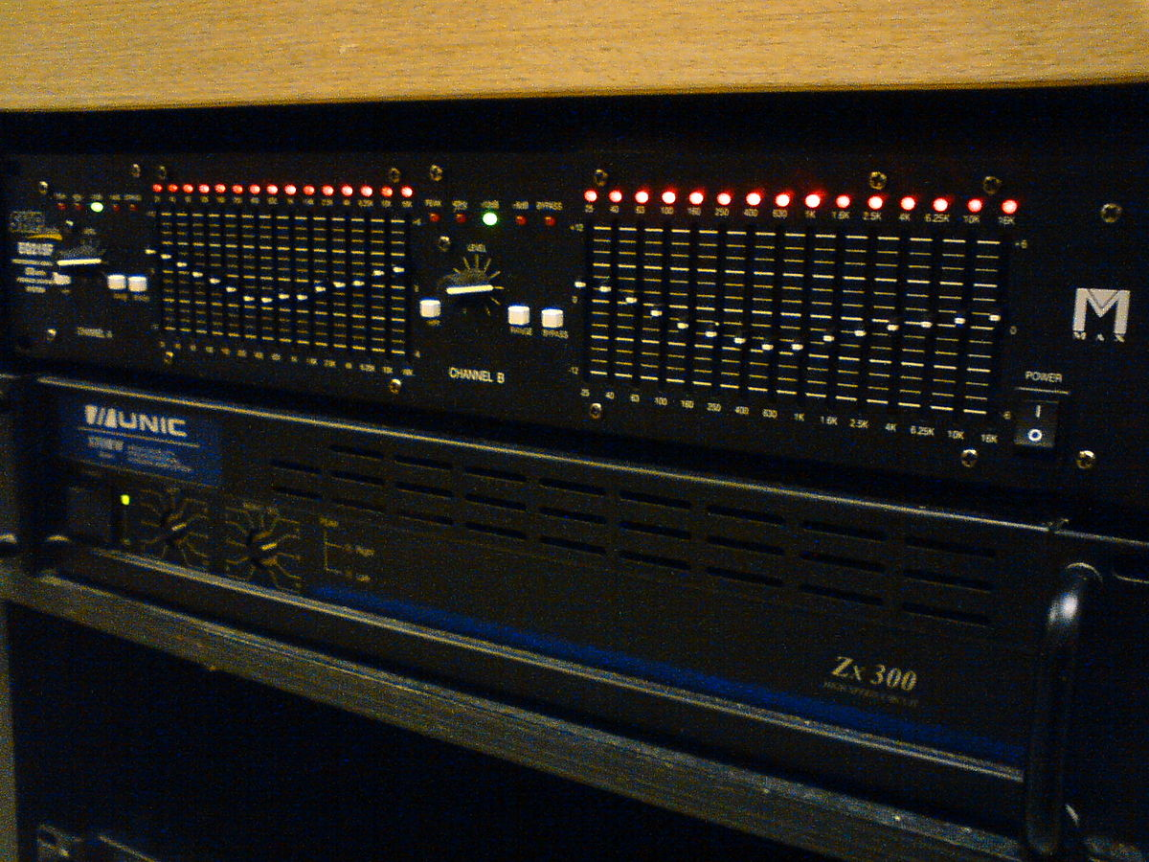
Problem approach – Data processing Approach 2: EQ / Filtering
Equalization (EQ) refers to the process of adjusting the volume of different frequency bands within an audio signal
Fundamentally, this means applying filters to different frequencies
Makes sense to examine the signals in frequency domain, especially in the human hearing range (20 Hz – 20 kHz)

Slide 15
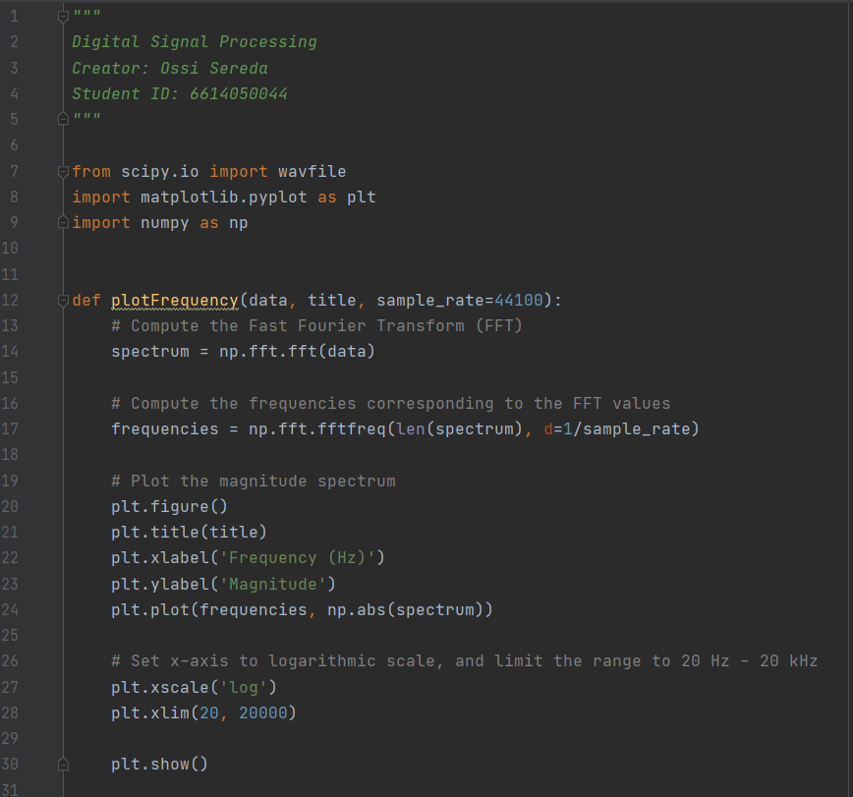
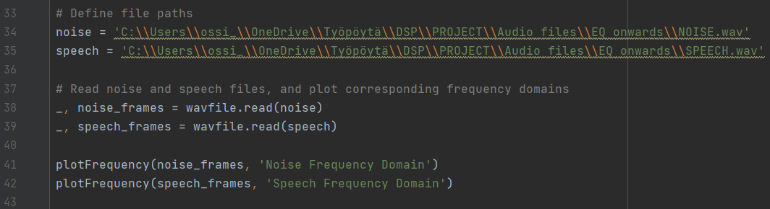
Script to plot separate speech and noise files in frequency domain
FFT computing
Logarithmic scaling
Human hearing range

Slide 16
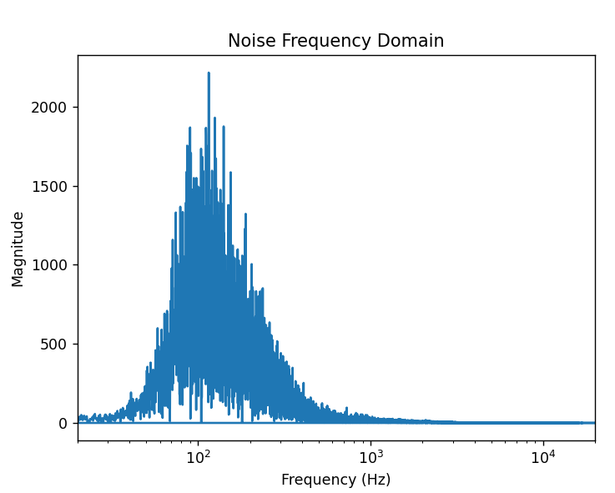
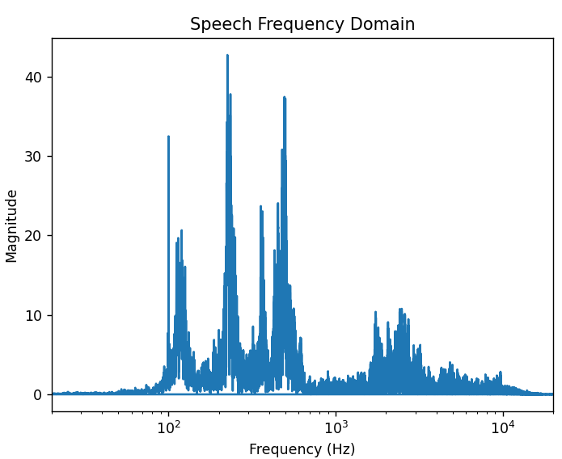
Majority of noise information resides in ≈ 70 – 200 Hz range
Fundamental speech frequency ≈ 120 Hz
After 1000 Hz
Little noise information
A lot of speech information
High-pass filter at 1 kHz to clear the noise?

Slide 17
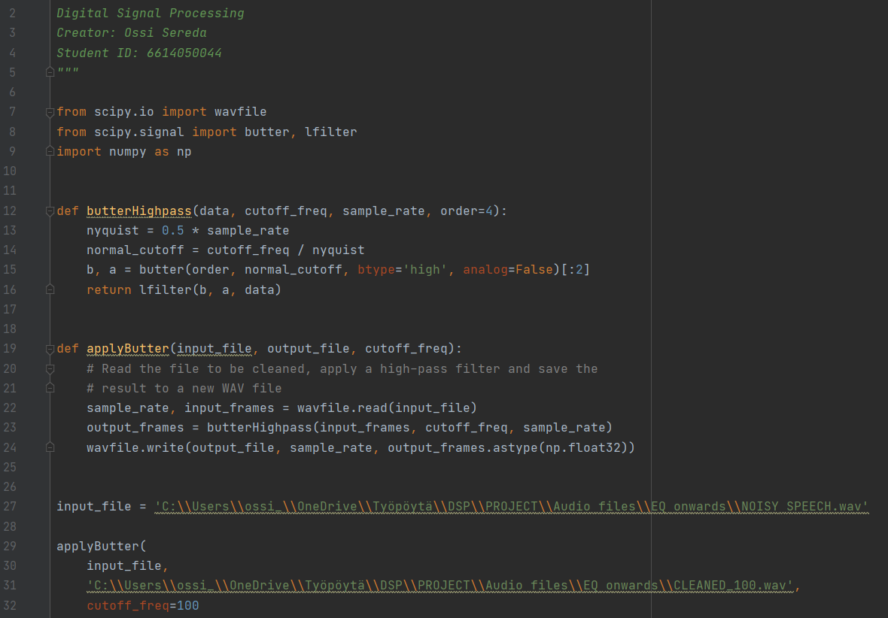
Cutoff frequency
0 Hz
100 Hz
250 Hz
500 Hz
750 Hz
1000 Hz
2000 Hz
1
2
3
4
5
6
7

Slide 18
Conclusions
Destructive interference
Works very well in an idealized context, where the accurate spectrums of the noise and target signals are known
Plausible in other situations too, but requires a less straightforward approach and extra analysis of signal
Filtering
Noise and target signals might have a difference on where the majority of signal information resides in frequency domain
If the main frequencies are on different extremities of human hearing range, simple high- and low-pass filters can work very well
Audio signals rarely have narrow frequency bands
Some form of frequency overlapping in two signals is often guaranteed
Rough filtering might make speech more intelligible, but also remove some fundamental frequencies, making the ”cleaned” speech sound unnatural

